Slide 1
Project 1: Data Analysis of Singapore’s Rainfall and its influence on Singapore’s Seafood Trade
Kenneth Lim

Slide 2
Table of Contents
Background, Problem Statement
01
02
Research Objective
03
Technical Analysis
04
Recommendations, Conclusions

Slide 3
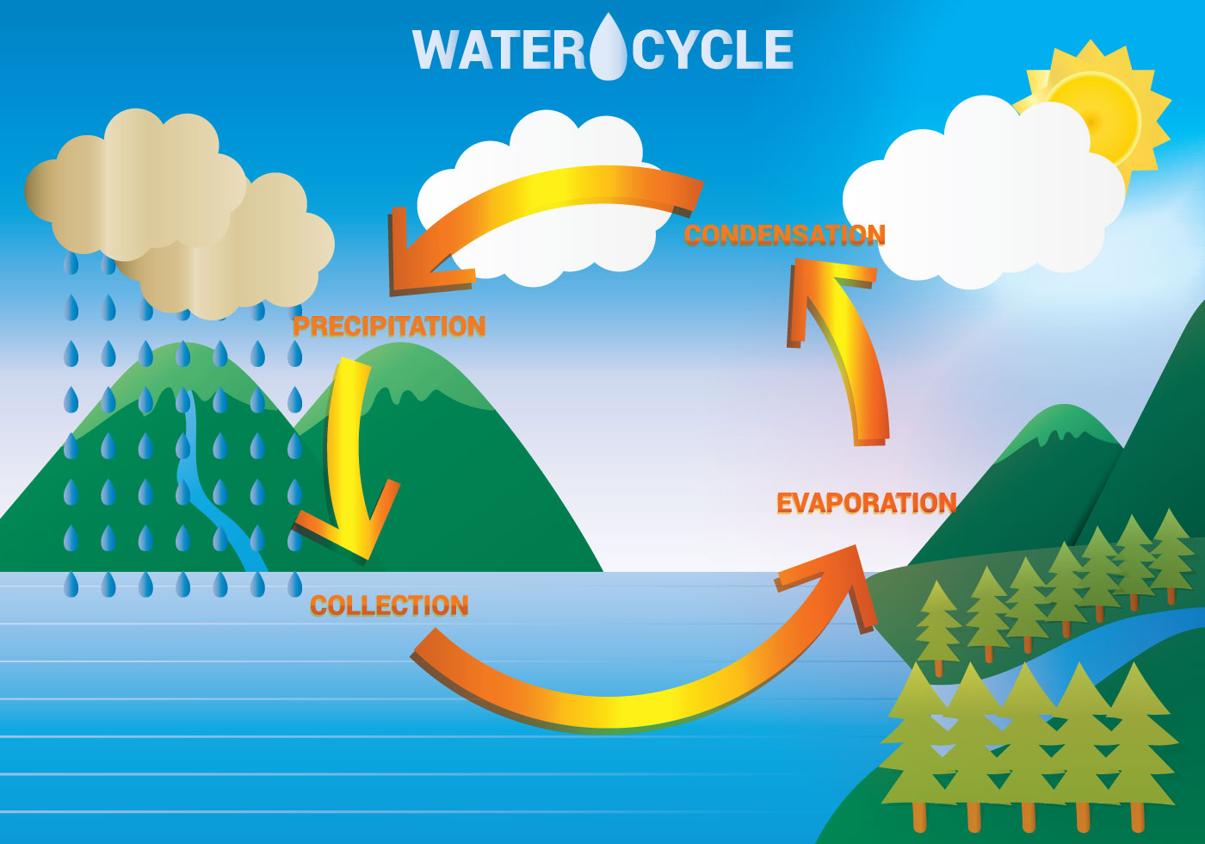

Slide 4
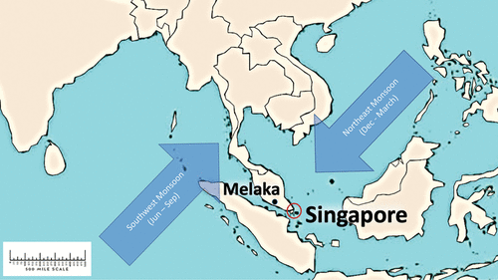
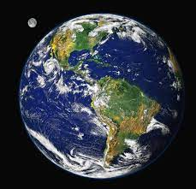
Background
Singapore is a tropical climate with abundant rainfall year round
Proximity to the equator gives features such as high temperature, high humidity
2 Monsoon seasons: Northeast Monsoon, Southeast Monsoon
Data Analyst employed by Singapore Food Agency

Slide 5
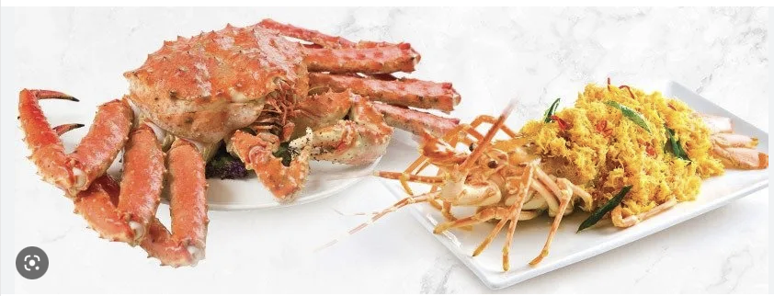
Problem Statement
How does Singapore’s weather parameters affect the overall seafood supply in the market?

Slide 6
Research Findings
More than 90% of Singapore’s food reserved are imported.

Slide 7
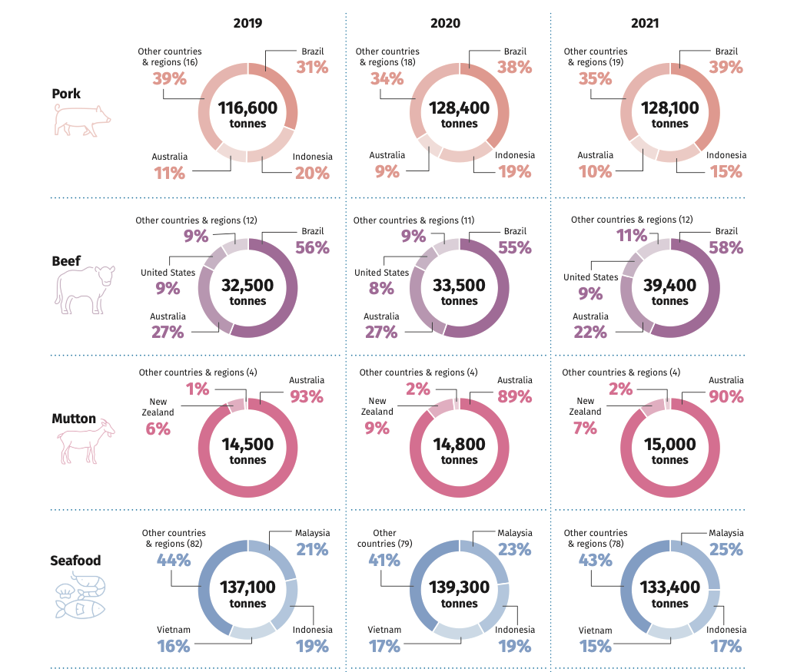
Source: https://www.sfa.gov.sg/docs/default-source/publication/sg-food-statistics/singapore-food-statistics-2021.pdf

Slide 8
Technical Analysis

Slide 9
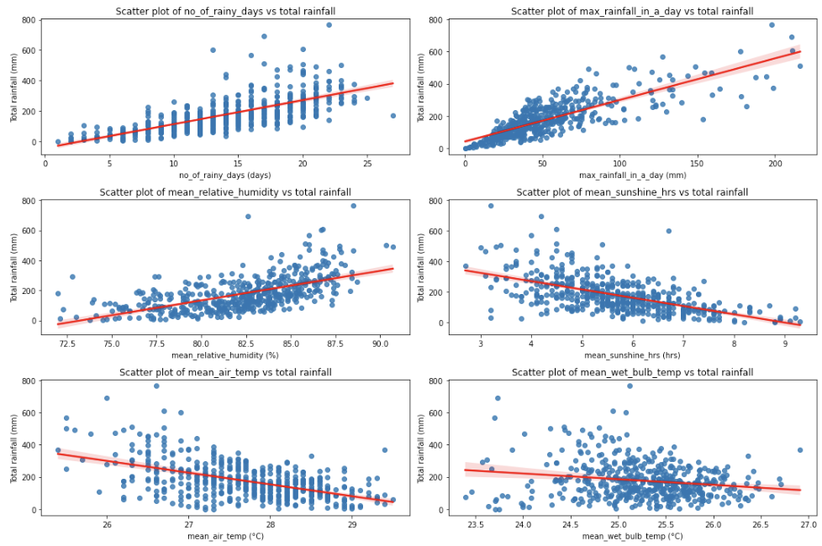
Analysis Trends of Total Rainfall & other Rainfall related parameters
Higher relative humidity -> More rainfall
Higher sunshine hours -> Less rainfall

Slide 10
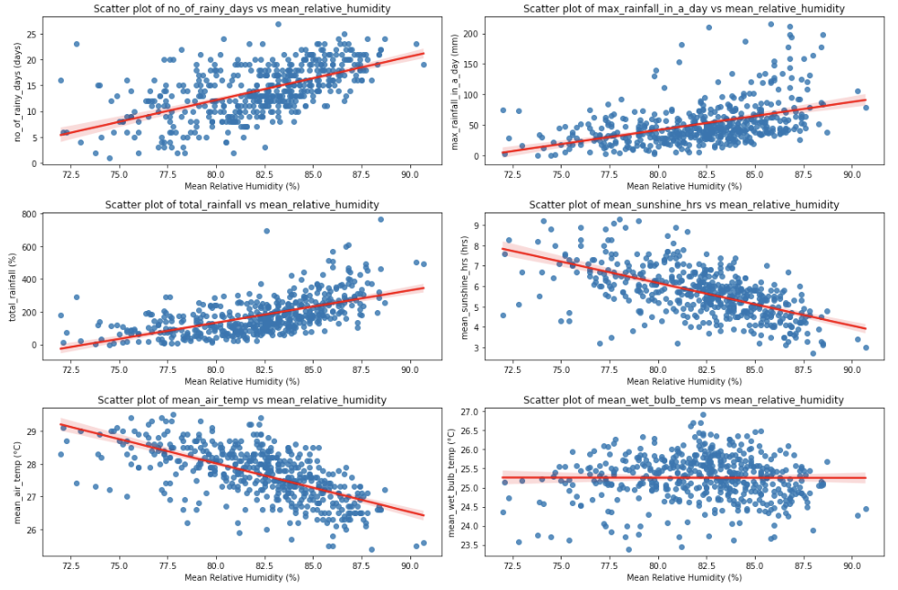
Analysis Trends of Relative Humidity & other Rainfall related parameters
Higher relative humidity -> More rainfall
Higher relative humidity -> Lesser sunshine
Higher relative humidity -> Lower air temperature

Slide 11
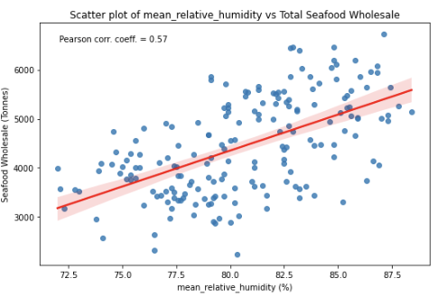
Analysis Trends of Relative Humidity & Total Seafood Wholesale
Higher relative humidity -> More Seafood catches from the ocean
?

Slide 12
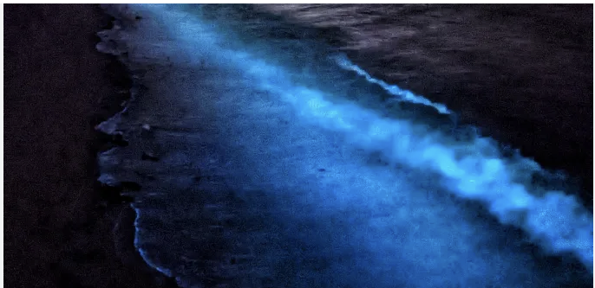
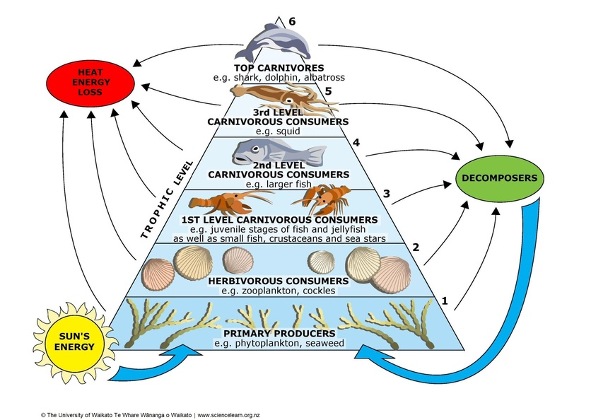
The Marine Food Chain
Tiny microorganisms in the oceans that are generate their own energy using CO2 and sunlight
Notes:
Phytoplankton are from a similar family to

Slide 13
Conclusion
Rainfall in Singapore is commonly influenced by common weather metrics such as air temperature, relative humidity, sunshine hours.
Relative humidity is suggested to be the key variable influencing rainfall patterns
Seafood supply and wholesale trade in Singapore is dependent on the relative humidity
Disruptions to plankton population in the ocean can threaten the marine ecosystem.

Slide 14
Recommendations
First level | Second level | Final level
Quantify the relationship of other weather related variables E.g. Atmospheric Pressure, Wind Speed, Cloud Cover | Incorporate Pollutant/Environmental Metrics E.g. CO2, Methane emissions | Quantify relationship between sales of seafood sub-types Relationship between seafood prices with weather variables
Weather | Environment | Economic

Slide 15
Thank You

Slide 16
Sources
1. IPCC Sixth Assessment Report 2022: Chapter 10: Asia. In Climate Change 2022: Impacts, Adaptation and Vulnerability
2. A sustainable food system for Singapore and beyond, SFA Singapore, 11 Nov 2022:
https://www.sfa.gov.sg/food-for-thought/article/detail/a-sustainable-food-system-for-singapore-and-beyond
3. IN FOCUS: How climate change can threaten food production in Singapore, CNA Singapore, 19 Dec 2020:
https://www.channelnewsasia.com/singapore/climate-change-singapore-food-production-fish-eggs-1340266
4. Enhanced phytoplankton bloom triggered by atmospheric high-pressure systems over the Northern Arabian Sea, Prasad G.Thoppil, 14 Jan 2023: https://www.nature.com/articles/s41598-023-27785-z
5. Climate change effects on aquaculture production, Global Seafood Alliance, 20 Sept 2021: https://www.globalseafood.org/advocate/climate-change-effects-on-aquaculture-production/
6. Climate of Singapore: http://www.weather.gov.sg/climate-climate-of-singapore/
7. National Geographic: Hydrologic Cycle: https://education.nationalgeographic.org/resource/hydrologic-cycle
8. What are Phytoplankton? NASA Earth Observatory: https://earthobservatory.nasa.gov/features/Phytoplankton

